Slide 1
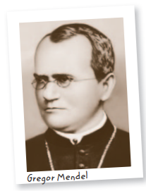
Mendel and heredity
When we think of how offspring resemble or differ from their parents, we typically refer to specific traits.
Traits are distinguishing characteristics that are inherited, such as eye color, leaf shape, and tail length. Scientists recognized that traits are hereditary or passed from one generation to the next.
Genetics is the study of biological inheritance patterns and variation in organisms. The groundwork for much of our understanding of genetics was established by Gregor Mendel
Scientists of the time commonly thought that parents’ traits were blended in offspring, like mixing red and white paint to get pink paint. But this idea failed to explain how certain traits remained without being “diluted.”
Mendel bred thousands of plants, carefully counting and recording his results. From his data, Mendel correctly predicted the results of meiosis long before chromosomes were discovered. He recognized that traits are inherited as discrete units from the parental generation. By recognizing that organisms inherit two copies of each discrete unit, what we now call genes, Mendel described how traits were passed between generations.

Slide 2
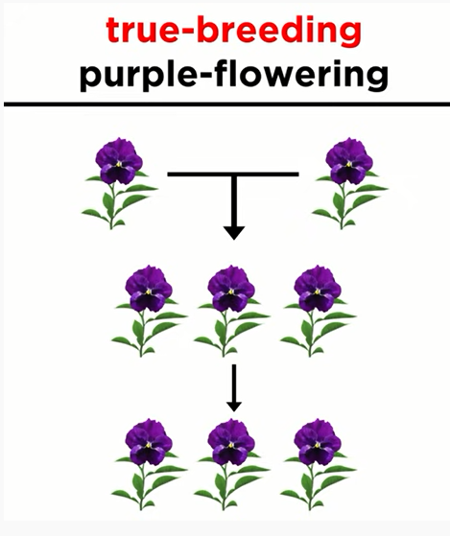
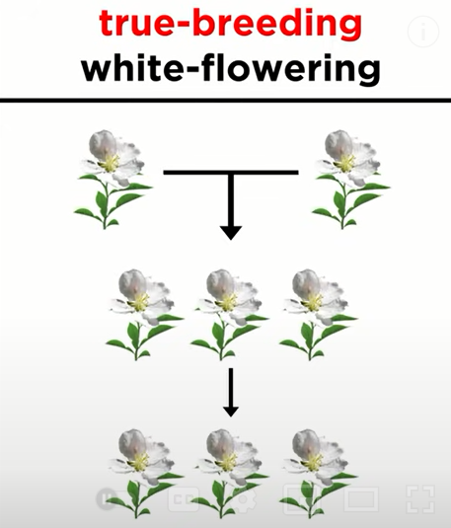
Mendel’s data revealed patterns of inheritance.
Mendel studied plant variation in a monastery garden. He made three key choices about his experiments that played an important role in the development of his laws of inheritance: control over breeding, use of purebred plants, and observation of “either-or” traits that appeared in only two alternate forms.

Slide 3
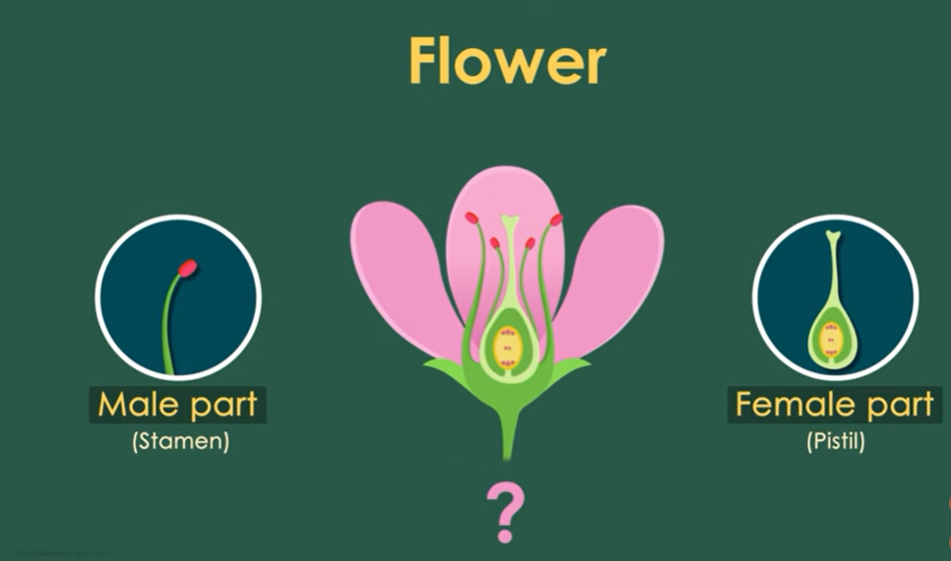
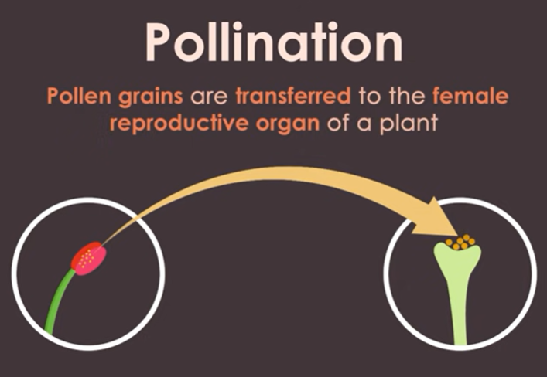
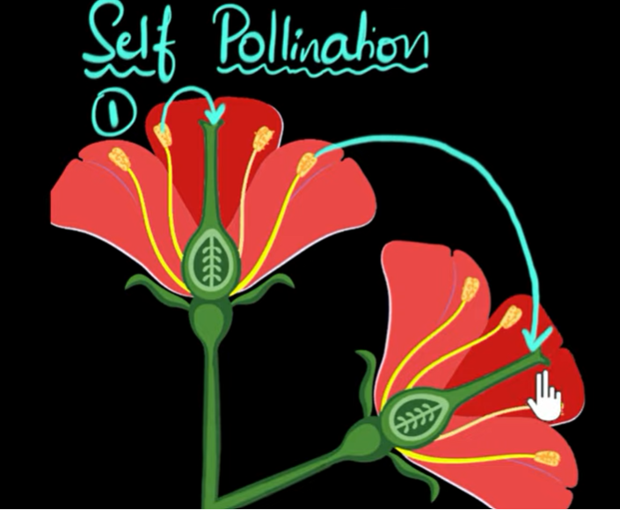
Experimental Design
Mendel chose pea plants for his experiments because they reproduce quickly, and he could easily control how they mate. The sex organs of a plant are in its flowers, and pea flowers contain both male and female reproductive organs.
In nature, the pea flower typically self-pollinates; that is, the plant mates with itself.

Slide 4
Experimental Design
If a line of plants has self-pollinated for long enough, that line becomes genetically uniform, or purebred. As a result, the offspring of purebred parents inherit all of the parent organisms’ characteristics.

Slide 5
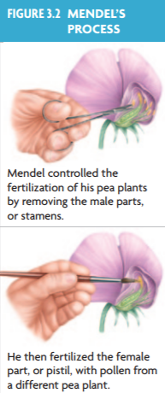
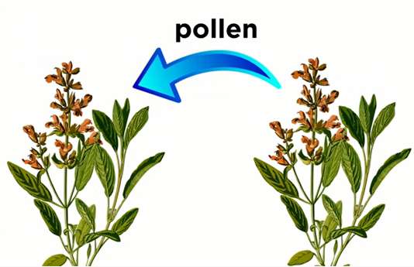
Experimental Design
Mendel was able to mate plants with specific traits by interrupting the self-pollination process. He removed the male parts of flowers and fertilized the female parts with pollen that contained sperm cells from a different plant. Because he started with purebred plants, Mendel knew that any variations in offspring resulted from his experiments.

Slide 6
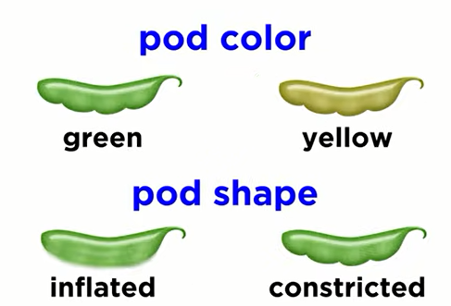
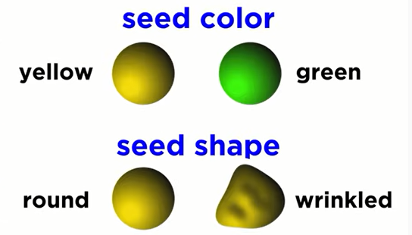
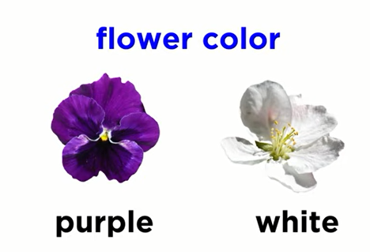
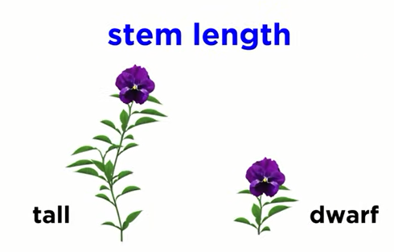
Experimental Design
Mendel chose seven traits to follow: pea shape, pea color, pod shape, pod color, plant height, flower color, and flower position. All of these traits are simple “either-or” characteristics; they do not show intermediate features. The plant is tall or short. Its peas are wrinkled or round. What Mendel did not know was that most of the traits he had selected were controlled by genes on separate chromosomes. The selection of these particular traits played a crucial role in enabling Mendel to identify the patterns he observed.

Slide 7
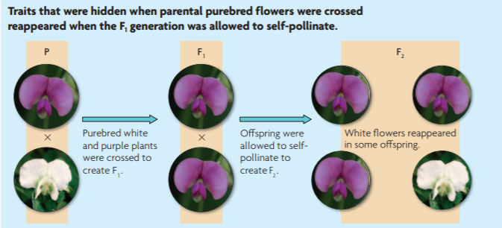
Results
In genetics, the mating of two organisms is called a cross.
In this example, Mendel crossed a purebred white-flowered pea plant with a purebred purple-flowered pea plant. These plants are the parental, or P, generation.
The resulting offspring, called the first filial—or F1—generation, all had purple flowers. The trait for white flowers seemed to disappear.
When Mendel allowed the F1 generation to self-fertilize, the resulting F2 generation produced both plants with purple flowers and plants with white flowers. Therefore, the trait for white flowers had not disappeared; it had been hidden, or masked.

Slide 8
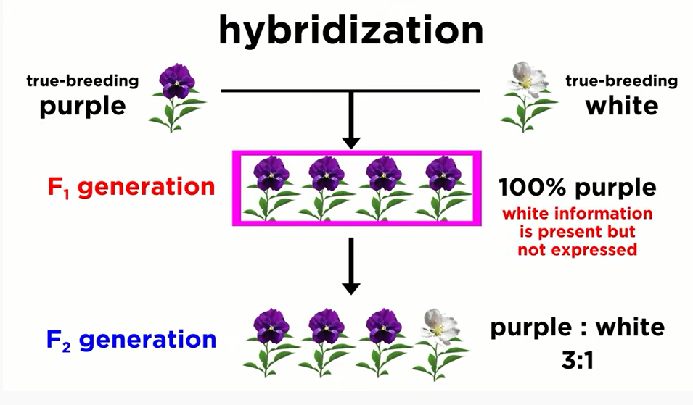

Slide 9
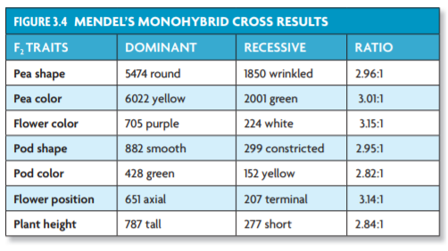
Results
Mendel did not cross only two plants, however; he crossed many plants. As a result, he was able to observe patterns.
He noticed that each cross yielded similar ratios in the F2 generation: about three-fourths of the plants had purple flowers, and about one-fourth had white flowers.
A ratio is a comparison that tells how two or more things relate. This ratio can be expressed as 3:1 (read “three to one”) of purple: white flowers. As you can see in FIGURE 3.4, Mendel’s data show this approximately 3:1 ratio for each of his crosses.

Slide 10
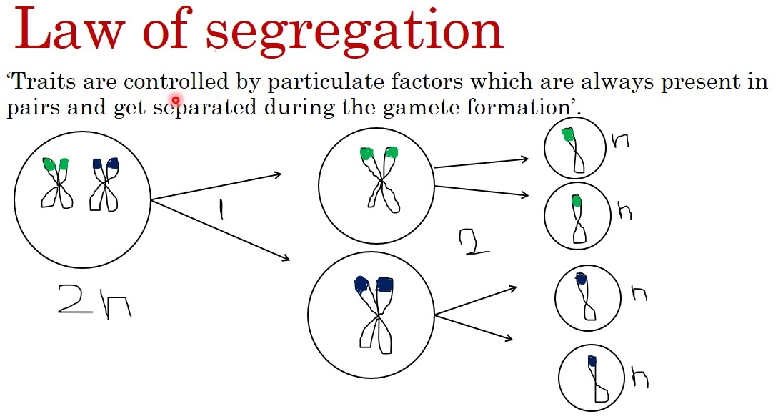
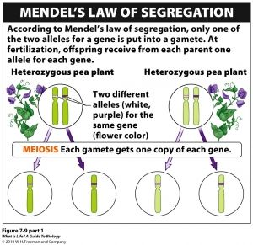
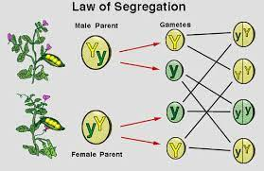
Conclusions
From these observations, Mendel drew three important conclusions:
• He demonstrated that traits are inherited as discrete units(every singe unit or gene was independent in its actions in an individual’s genome), which provided an explanation for individual traits that persisted without being blended or diluted over successive generations. Mendel’s two other key conclusions are collectively called the law of segregation, or Mendel’s first law.
• Organisms inherit two copies of each gene, one from each parent.
• Organisms donate only one copy of each gene in their gametes. Thus, the two copies of each gene (allele) segregate, or separate, during gamete formation.

